Slide 2
Introduction to the
Climate Futures Framework
John Clarke, Tim Erwin

Slide 3
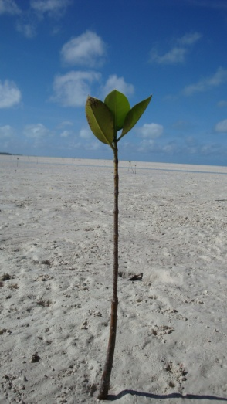
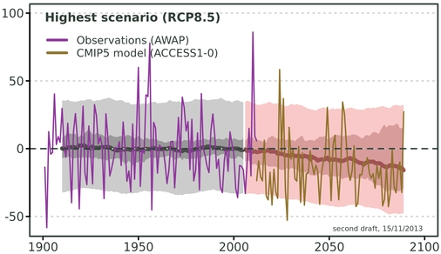
Impact Assessment
Climate projections are used in a variety of impact assessments
The level of detail depends on the objectives of the decision-makers, e.g. less detail is required for general awareness-raising than designing a new road
Not “one size fits all”, so climate projections need to be purpose-built
Because of the uncertainty, often use a “risk management” approach to evaluate important “cases”, e.g.
“Best” Case
“Worst” Case
“Maximum Consensus” Case (if there is one)
}
?
}
Notes:
Climate projections are used for a wide range of purposes, from general information through to specialised and detailed impact assessments
The level of detail required in the projections depends on the needs of the decision-makers involved and the complexity of the impact assessment to be undertaken
For example, much less detail is required for communication products to raise general awareness than when designing a ‘climate-proof’ road.
This means it is not sensible (or even possible) to provide ‘one size fits all’ projections products. Rather the projections need to be purpose-built.
In addition, the sometimes wide range of results produced by climate models, such as those shown in the plot (often referred to as ‘uncertainty’) means it is sensible to use a risk management approach to evaluate particularly important cases such as:
What may be described as the ‘best’ case,
The ‘worst’ case, and
If possible, the ‘maximum consensus’ case

Slide 4
Typical climate projections
Typically projections are for individual climate variables for selected years and emissions scenarios
Projections expressed as a central tendency (e.g. mean or median) with a range of uncertainty, e.g.
2°C (1-3°C) warmer
10% (5-15%) wetter
OK for general information and working with single climate variables, but...
What if your impact assessment needs to consider multiple variables jointly (e.g. crop growth, species distributions)?
Notes:
However, typically climate projections data are presented for individual climate variables (e.g. temperature, rainfall) for selected years and emissions scenarios
In these projections, the results from many different climate models are combined and the projected changes provided as an average with a range of uncertainty such as in the examples below
This is useful for general information and for impact assessments that need to consider only one variable, however
many impact assessments require input from multiple variables
For example, a crop model may require daily temperature, rainfall, humidity, evapotranspiration and solar radiation data

Slide 5
Typical climate projections & Internal Consistency
Temperature change: +1.7 (+1.1 to +2.6) °C
Rainfall change: -2.4 (-15.0 to +12.9) %
Notes:
Consider this example:
The results are presented as an average change in temperature (in degrees Celsius) and rainfall (in %)
However, let’s consider the underlying results from which these results are calculated...

Slide 6
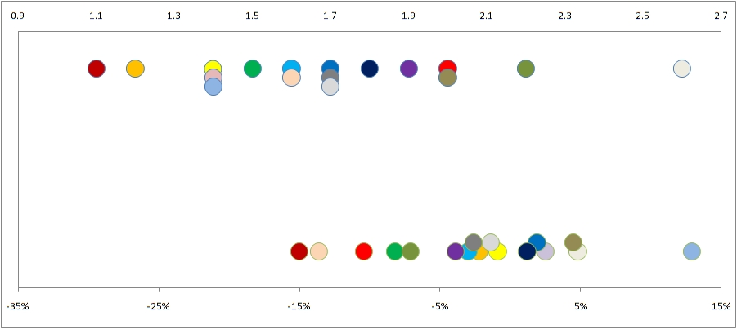
Typical climate projections & Internal Consistency
Temperature change: +1.7 (+1.1 to +2.6) °C
Rainfall change: -2.4 (-15.0 to +12.9) %
°
°
°
°
°
°
°
°
°
°
Temperature
Rainfall
Notes:
This plot shows the projected change in temperature across the top and change in rainfall across the bottom
Each coloured dot represents the results from a single climate model
For example, the Red Model projects an increase of +1.1°C and a corresponding decrease of 15% in rainfall
Similarly, we can examine the projected changes in temperature and rainfall for each model
Each model projects a particular change in temperature and rainfall based on the established laws of physics and thermodynamics that describe our understanding of the climate system

Slide 7
Typical climate projections & Internal Consistency
Temperature change: +1.7 (+1.1 to +2.6) °C
Rainfall change: -2.4 (-15.0 to +12.9) %
But you know none of this if all you have is a mean and range!
Notes:
However, we know none of this if all we are provided with are the average changes and their associated ranges

Slide 8
Typical climate projections & Internal Consistency
Temperature change: +1.7 (+1.1 to +2.6) °C
Rainfall change: -2.4 (-15.0 to +12.9) %
°
°
°
°
°
°
°
°
°
°
Temperature
Rainfall
Notes:
Now, let’s imagine we’re interested in evaluating the impact of the hottest and driest case – how would we do this using the multi-model averages and associated ranges?
We might be tempted to use the maximum temperature value from the range
and the minimum rainfall value.
However, if we do this we are very likely combining the results from two quite different climate models.
These results are likely to be inconsistent with the laws of physics
In our example, the maximum temperature value comes from a climate model that produced a small increase in rainfall and,
the driest model simulated the lowest temperature

Slide 9
Typical climate projections & Internal Consistency
Temperature change: +1.7 (+1.1 to +2.6) °C
Rainfall change: -2.4 (-15.0 to +12.9) %
°
°
°
°
°
°
°
°
°
°
Temperature
This combination is not simulated by any model, and
it only represents a tiny subset of all the possibilities
How can we obtain ‘internally consistent’ data and also adequately sample the range of model results?
Rainfall
Notes:
Not only is this combination not simulated by any climate model but,
it also only represents a tiny subset of all the possible future climates – all of which are plausible.
Clearly, it would be better to have results that are consistent with the physics of the climate models
We call this type of data “internally consistent”.

Slide 10
What do we want from the projections?
Internally Consistent Data
Adequately Sample the Range
Achievable
Information on Model Agreement (> likelihood)
Credibility (model evaluation)
Notes:
To solve this problem, let’s consider what it is that we really need from the climate projections in order to be able do quality impact assessments.
We’ve already seen why we need internally consistent data
and that we should adequately sample the range of the projections
At the same time we must acknowledge that most people only have the resources to work with a small number of models, so we need a system that is achievable
Decision-makers need information of the likelihoods of particular outcomes to use in their risk management frameworks. If we can provide information on model agreement, this will assist them in determining likelihoods.

Slide 11
Using individual models for impact assessment – every model
Climate Model 1
Impact Model
Assessment 1
Climate Model 2
Impact Model
Assessment 2
Climate Model 3
Impact Model
Assessment 3
Synthesis and Evaluation
Climate Model 4
Impact Model
Assessment 4
........
........
........
Climate Model 40
Impact Model
Assessment 40
Notes:
If we have the resources, we can use the results from each available model and run these through our impact assessment process separately. The results of each impact assessment can then be evaluated and synthesised.

Slide 12
What we want from projections
- using every model
✓
Internally Consistent Data
Adequately Sample the Range
Achievable
Information on Model Agreement
✓
?
✗
Notes:
How does the approach of evaluating models individually score against our requirements?
Provides internally consistent data
Comprehensively samples the range of projections as it uses all models
Is unlikely to be achievable for most people as the time, effort and possibly computing resources required are substantial
Does not provide any information on model agreement so does not contribute to an understanding of the likelihoods of each case

Slide 13
Using individual models for impact assessment – “Best” model approach
Climate Model 1
Impact Model
Assessment 1
Climate Model 2
Impact Model
Assessment 2
Synthesis and Evaluation
Climate Model 3
Impact Model
Assessment 3
Notes:
Some studies choose a subset of models based on how well they simulate aspects of the past climate
This usually takes no account of which part of the projections space the model fall within.

Slide 14
What we want from projections
- ‘best’ models
✓
Internally Consistent Data
Adequately Sample the Range
Achievable
Information on Model Agreement
?
✓
✗
Notes:
Choosing the ‘best’ models:
Provides internally consistent data
May or may not adequately sample the range of projections, depending on the method used to identify the models to be used
Is achievable as only a small number of models have to be used
Does not provide any information on model agreement so does not contribute to an understanding of the likelihoods of each case

Slide 15
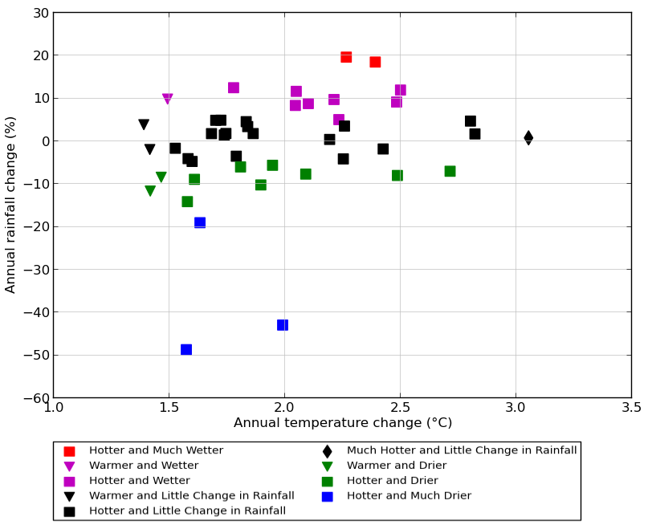
Start with what the models say...
An alternative approach
Notes:
Here the projected changes in two variables for a particular future time and emissions scenario are shown for each model
In this case, we’ve used temperature and rainfall – but it could be others
This is simply a different way to view the results from a number of climate models
You can see the range in the projected temperature and rainfall changes
Because each climate model uses the laws of physics and thermodynamics to simulate it’s version of the climate, we know the results from a single model are internally consistent.
But if we use a single model, we do not adequately sample the range of model results
Can we select a subset of the models to reduce the number of times we have to do the impact assessment?
How do we choose a subset in a scientifically valid and reproducible way?

Slide 16
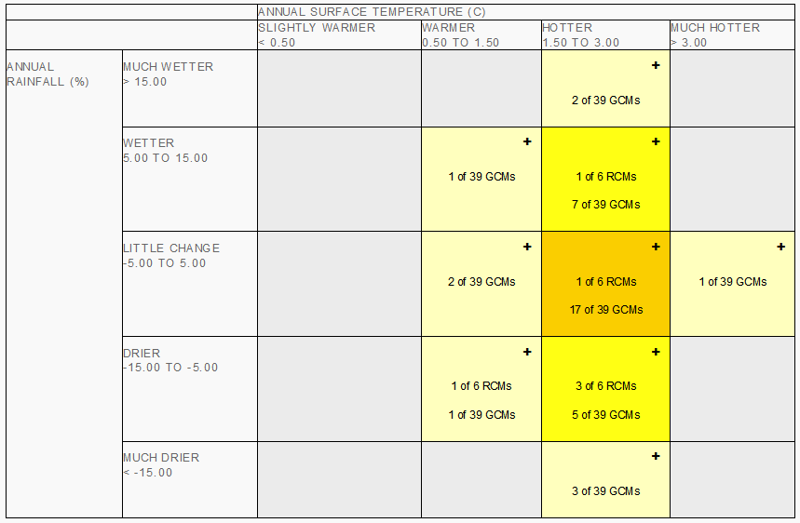
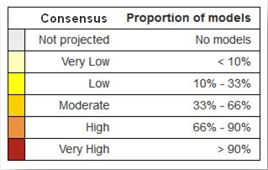
From Scatter-plot to Matrix
Notes:
This is the Climate Futures Matrix – it essentially shows what we just saw in the scatterplot.
In the Climate Futures web-tool, the results are simplified by hiding the individual models and simply presenting a tally of how many models (if any) fall within each grid box of the matrix.
These grid boxes are called Climate Futures.

Slide 17
‘Climate Futures’ approach
Work with the decision-makers, identify:
Current sensitivity (what climate variables impact on the suitability of infrastructure):
Key Cases
Best: future with highest rainfall and least evaporation
Worst: future with lowest rainfall and highest evaporation
Maximum Consensus (if possible) or Mid-range
Use Representative Model Wizard to identify models to appropriately represent each Key Case
Draw on existing information on model skill
Notes:
We can now use the matrix (usually working with decision-makers) to identify
The Climate Futures (or ‘key cases’) that will have the most affect on their decisions
The Representative Model Wizard function of the Climate Futures tool provides an objective means of identifying one or more models to represent each of the Key Cases
At this point it is sensible to draw on any information available on model performance and skill. In practice this means simply avoiding models with low skill in the region of interest.

Slide 18
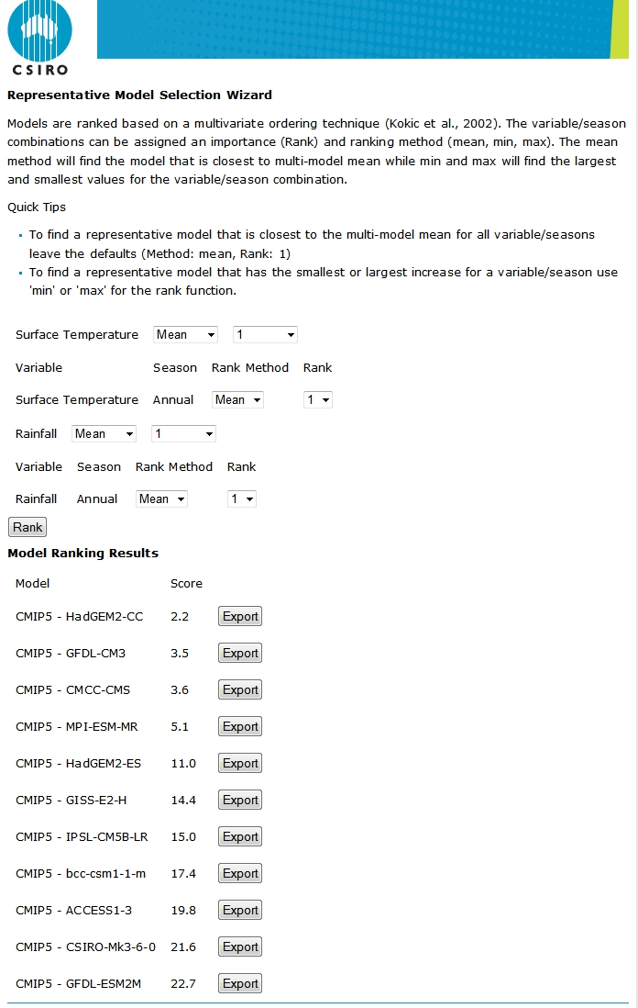
Key Cases
Best case
✗
✗
✗
✗
‘Maximum Consensus’
✗
✗
Worst case
Notes:
This climate future is called the Maximum Consensus Climate Future because:
It contains at least 1/3 of the available models, and
It contains at least 10% more models than any other climate future
The results from the Representative Model Selection Wizard shows how well each model fits to the mean of the climate future (it could also be set to base the ranking on minimum or maximum)
The models are ranked from best fit at the top to worst fit at the bottom.
This shows that the HadGEM2-CC model is the most representative of the Maximum Consensus Climate Future.

Slide 19
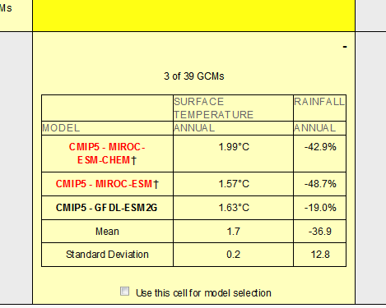
From Scatter-plot to Matrix
Notes:
We can do a similar ranking for the ‘Worst Case’ – which has a Very Low consensus (as extreme cases often do)
Once we’ve done the ranking though, we should check for model skill information.
Clicking on the + sign in the climate future expands the grid cell to display the individual models and their results.
In this case, two models are ‘flagged’ in red. This is because there are concerns about their skill in representing important aspects of the climate in the relevant region. It would be preferable to not use these models in the impact assessment.

Slide 20
Using the results in an impact assessment
Case | Climate Future | Consensus | Representative Model
‘Best’ | Hotter, Wetter | Very Low | NorESM1-ME
‘Worst’ | Much Hotter, Much Drier | Low | IPSL-CM5A-LR
‘Maximum Consensus’ | Hotter, Much Drier | Moderate | HadGEM2-ES
Obtain required data from each model
From CCiA website (incl. GCM, downscaled, maps, GIS, time-series)
NARCliM, Climate Futures Tasmania, Goyder Institute
Other sources (e.g. Tyndall Centre, CliMond)
Contact us
Run assessment for each model to evaluate each case
Use model consensus information to assist weighing up likelihoods of each case
Notes:
Once representative models have been identified for each of the key cases, the information should be recorded – such as in this table.
From this point on, the impact assessment need not use those highly ‘user-friendly’ (not!) model names. Instead, we can just talk in terms of best, worst and maximum consensus cases.
All that remains is to obtain the data!
You can use CCIA data or any other that meets your needs

Slide 21
Using individual models for impact assessment – key cases: Climate Futures
‘Best’ Case (with model consensus information)
Climate Model 1
Impact Model
Assessment 1
‘Worst’ Case (with model consensus information)
Climate Model 2
Impact Model
Assessment 2
Synthesis and Evaluation
‘Maximum Consensus’ Case
Climate Model 3
Impact Model
Assessment 3
Notes:
Now let’s check back in with our conceptual model for the key cases approach…
Most studies choose a ‘worst’ case and ‘best’ case to evaluate
Maximum consensus is also commonly chosen
On rare occasions, just one case may be assessed – but the reasons must be compelling and adequately explained. An example might be if you’re interested in understanding what the maximum cost of adaptation might be, you could consider just the worst case.

Slide 22
What we want from projections
- key cases from Climate Futures
✓
Internally Consistent Data
Adequately Sample the Range
Achievable
Information on Model Agreement
Whether using a subset or all models
✓
✓
✓
Notes:
So…how does the Climate Futures based key cases approach stack up against our checklist?
Using Climate Futures to identify key cases and choose representative models:
Provides internally consistent data
Samples the range of projections in a way that is tailored to impact assessment being undertaken
Is achievable as only a small number of models have to be used
Provides information on model agreement and thus can contribute to an understanding of the likelihoods of each case
Furthermore, the model agreement information can be applied whether using two or three models to represent key cases or using all models.

Slide 23
Further Information
The conceptual and scientific basis of the Climate Futures Framework
Whetton P, Hennessy K, Clarke J, McInnes K, Kent D (2012) 'Use of Representative Climate Futures in impact and adaptation assessment.' Climatic Change 115, 433-442. 10.1007/s10584-012-0471-z.
Application of the Climate Futures Framework
Clarke JM, Whetton PH, Hennessy KJ (2011) 'Providing Application-specific Climate Projections Datasets: CSIRO’s Climate Futures Framework.' Peer-reviewed conference paper. In F Chan, D Marinova and RS Anderssen (eds.) MODSIM2011, 19th International Congress on Modelling and Simulation. Perth, Western Australia. December 2011 pp. 2683-2690. ISBN: 2978-2680-9872143-9872141-9872147. (Modelling and Simulation Society of Australia and New Zealand). http://www.mssanz.org.au/modsim2011/F5/clarke.pdf.
Climate Change in Australia Online Training: Module 4 The Climate Futures Framework
https://www.climatechangeinaustralia.gov.au/en/climate-campus/online-training/climate-futures-framework/
Climate Change Animations (including one on Australian Climate Futures)
https://www.climatechangeinaustralia.gov.au/en/support-and-guidance/tools-communicators/communication-resources/animations/
Notes:
More information is available from these resources

Slide 24
CONTACT US
CCIA Team
CSIRO Climate Science Centre
e: climatefutures@csiro.au
w: www.csiro.au

